Slide 1
AirFare Prediction Analysis

Slide 2
Exploratory Data Analysis

Slide 3
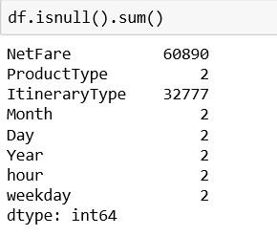
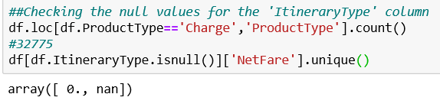

Data Inspection
It is observed that index no 180141 and 180143 contains all the null values, So we drop these rows
Since the Netfare of all the charges product type is zero and there is no mention of itinerary type, international or domestic. These variables are not giving any weightage to our data, Hence we eliminate them
It is seen that out of 60889 null values –
Payment product type - 55394
Refund product type – 5495
Thus it is advisable to remove the rows with product type refund and payment

Slide 4
EDA – Product type
Since Other product types other than Air has not shown any significant correlation with Netfare , we decided to go with Model builiding with Product type Air and Intinerary type. We have taken approach to build 2 seperate models for Domestic and International

Slide 5
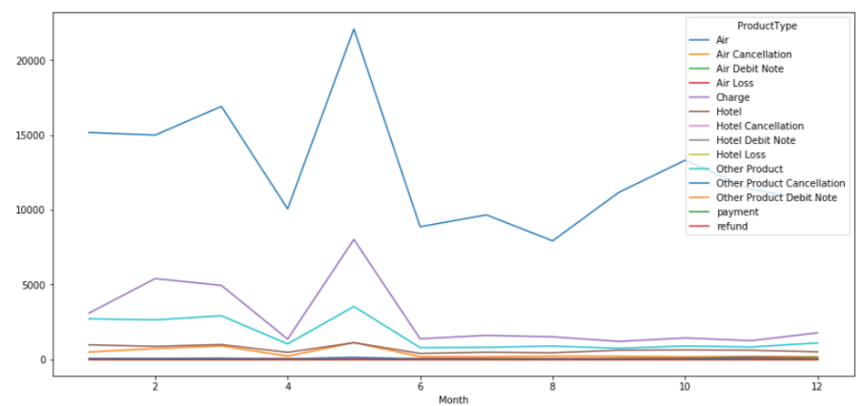
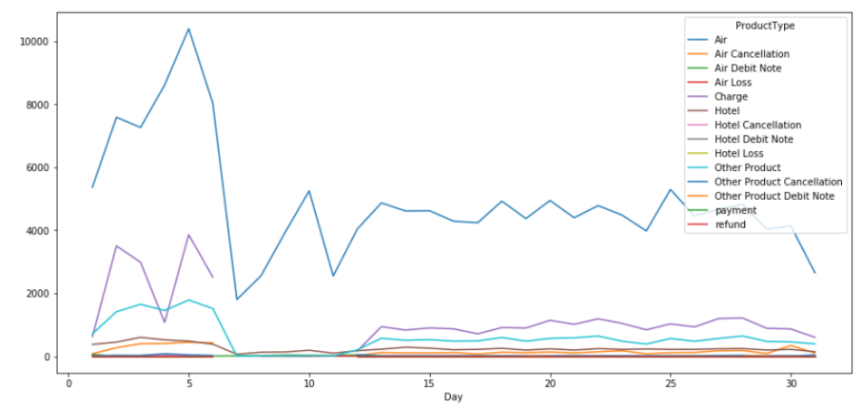
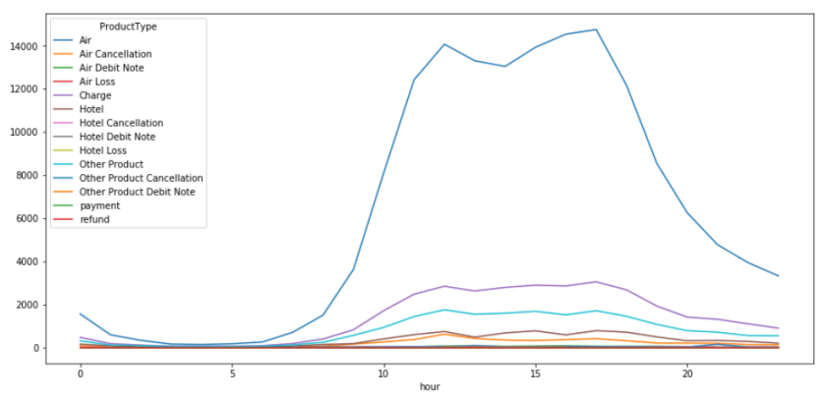
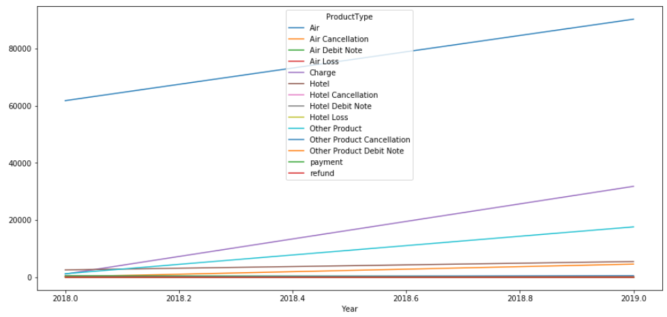
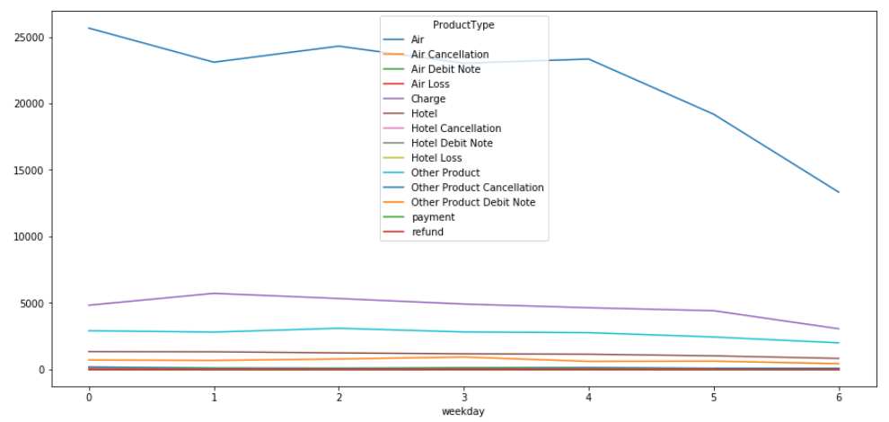
EDA – Product type
It is observed that fluctuations are significant only for product type – air. Refund and Charges show slight fluctuation however the corresponding netfare value is 0 & correlation is very low. Hence it is recommended to consider only air product type.

Slide 6
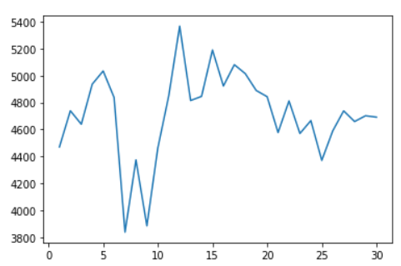
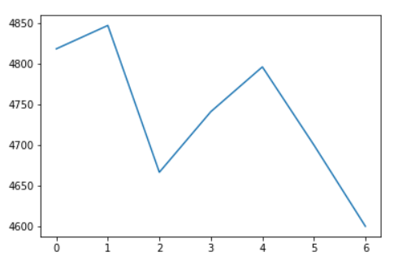
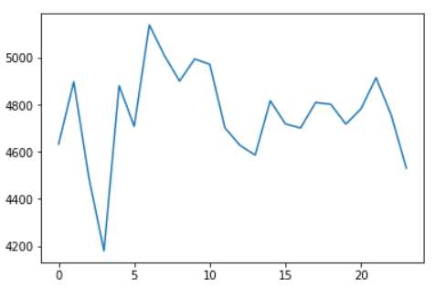
EDA - Air and Domestic
As per Shapiro Wilk test, the distribution is not gaussian
Highest Air travel - May ,less air travel in June – August due to monsoon season, picks up from September during the festive season
High volume of travel during 1-5th of the month, Less travel observed during Saturday and Sunday
Increase in counts in the daytime starting from 7am in the morning until 9 pm
Similar trends observed when checked with avg fare which implies that price increases as the no of travelers increases

Slide 7
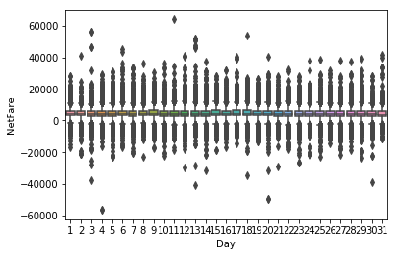
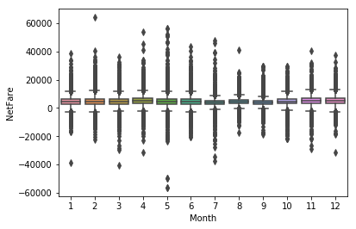
EDA - Air and Domestic
Boxplot based on days shows almost similar Avg Netfare with lot of outliers
We can also see some negative values
Highest Average Netfare is recorded on Day 15 = 5191
Lowest Netfare is recorded on Day 25 =4371
Monthwise Average Netfare plot shows high Netfare recorded during vacations and festivals i.e
in the Month of April = 5208 and November = 5080
Lowest Netfare recorded during July clearly the monsoon season = 3978

Slide 8
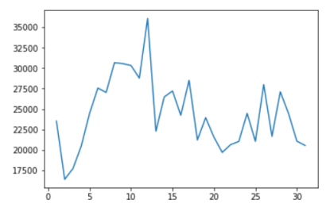
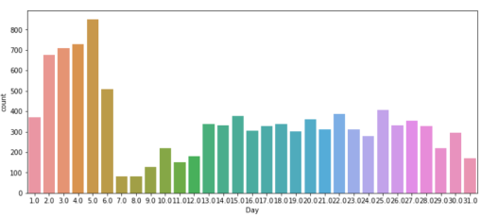
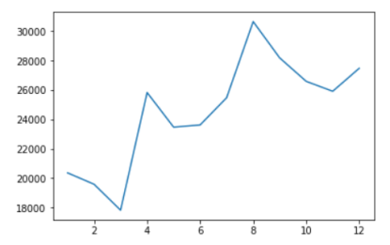
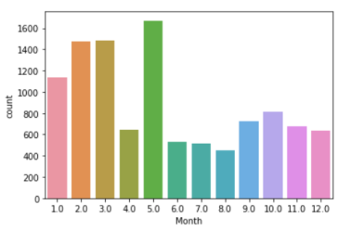
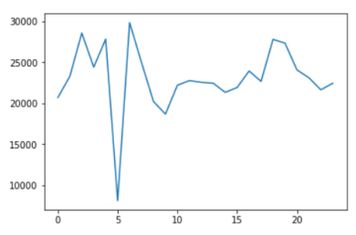
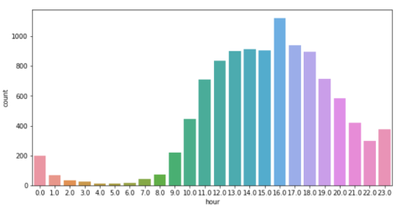
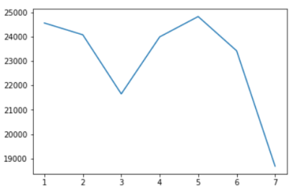
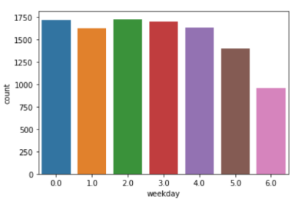
EDA – Air and International
Avg Netfare is higher on 12th and lower on 2nd day of the month. Higher volume during 1-5th day
Netfare is higher August mainly due to Summer vacations in USA ,UK lies between August and September and lowest in March
Avg Netfare shows a drop at 5am in the morning, post which it again spikes up and high volume in day
Avg Netfare is lower over the weekends and low volume as well

Slide 9
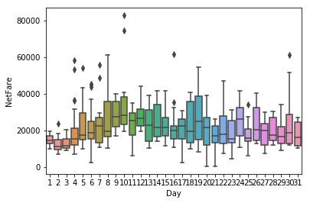
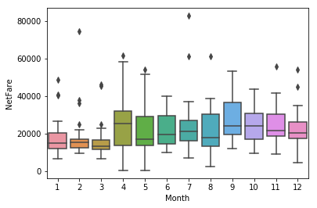
EDA – Air and International
Boxplot based on days shows quite a few fluctuations in Avg netfare unlike to Domestic with very few outliers
Highest Average Netfare is recorded on Day 10 = 36,343
Lowest Netfare is recorded on Day 2 =12,548
Monthwise Average Netfare plot shows high Netfare recorded during vacations i.e
in the Month of Sepetmber = 26,770
Lowest Netfare recorded during March = 15,693

Slide 10
Model Building

Slide 11
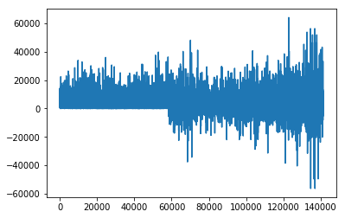
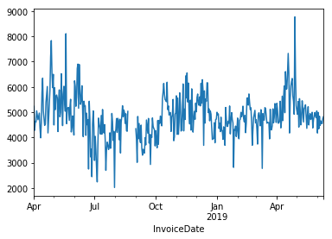
Domestic
Netfare for all records
Total number of records with ItinteraryType as Domestic and Product type Air = 1,41234
Data is Non-stationary
Netfare based on daily Average
Number of records after computing the daily average = 436
Data is stationary as per DF test

Slide 12
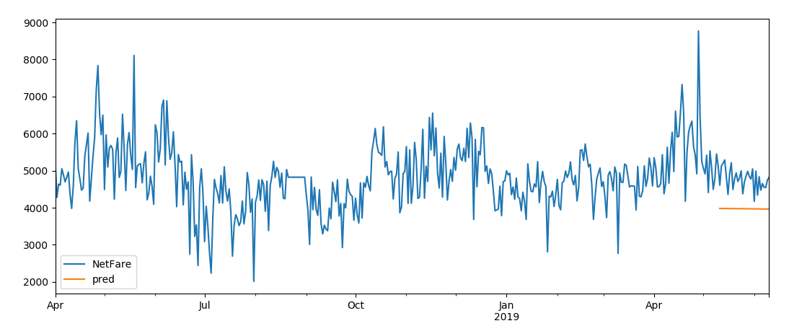
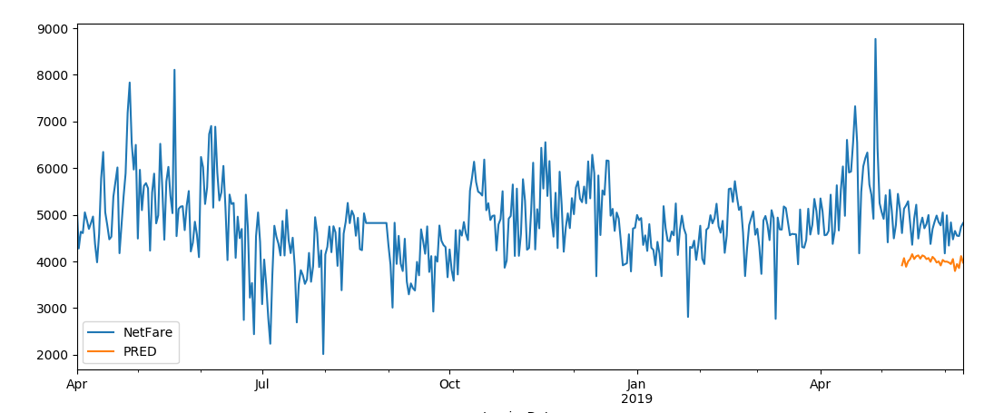
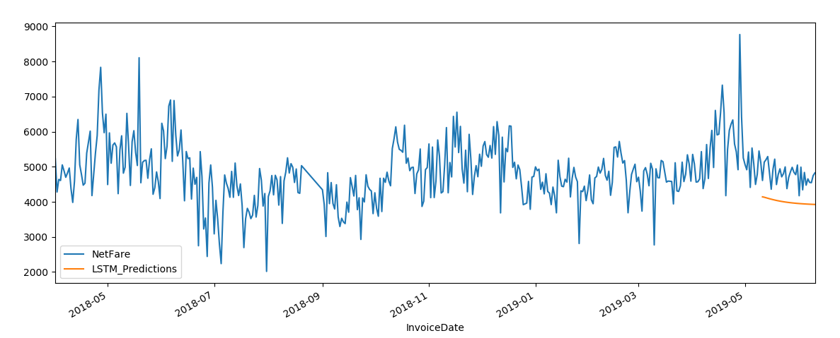
SARIMAX
Domestic
ARIMA
RMSE - 322 , MAE - 276
RMSE - 358 , MAE - 311
LSTM
RMSE - 326 , MAE - 293

Slide 13
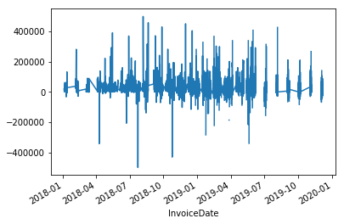
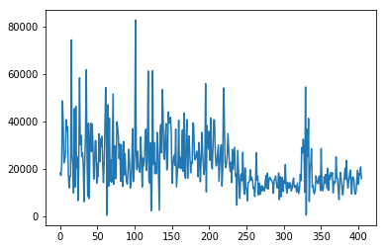
International
Netfare for all records
There are 20,458 records with ItinteraryType as Intl and Product type Air =20,458
Data is stationary
Netfare based on daily Average
Number of records after computing the daily average = 405
Data is stationary as per DF test

Slide 14
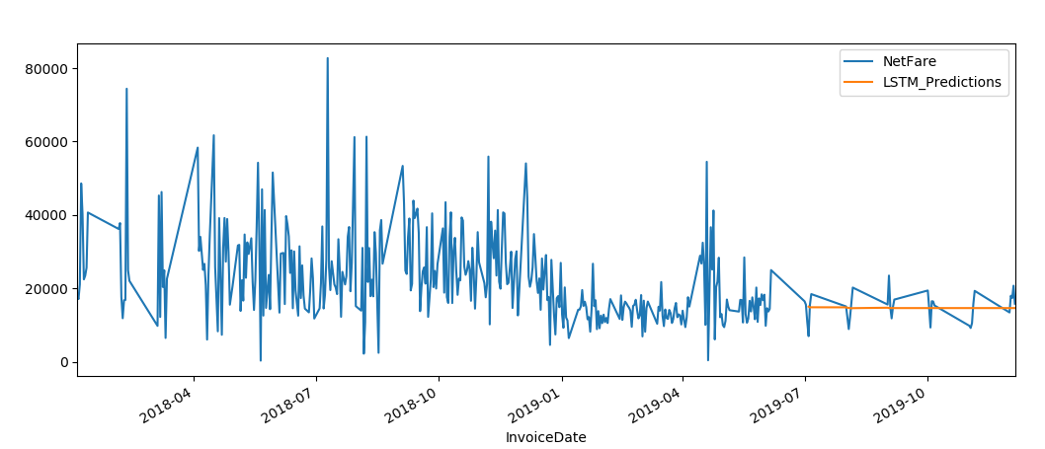
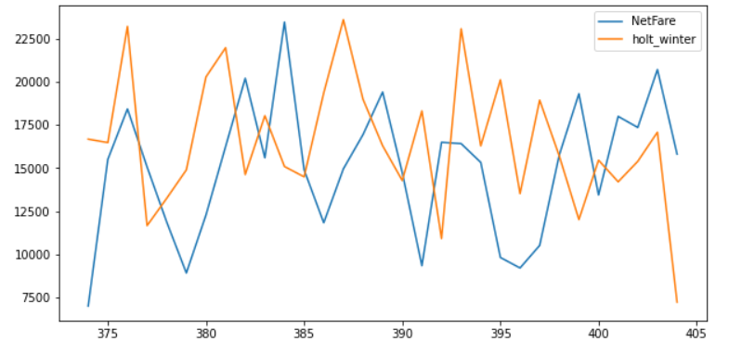
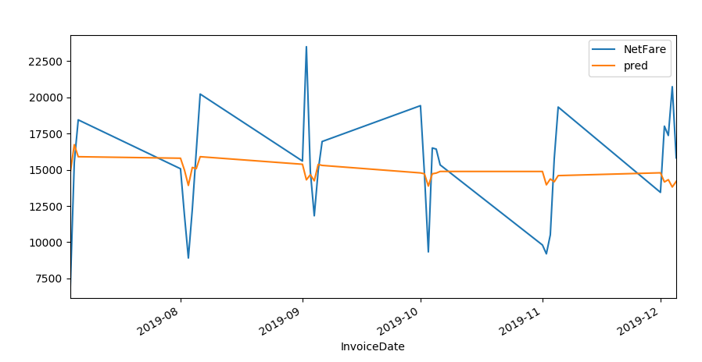
International
LSTM
Holt Winter
RMSE - 3858, MAE - 3082
RMSE = 5077 , MAE = 4881
ARIMA
RMSE-3762 , MAE -2993

Slide 15
Accuracy Matrix using Model Based Techniques :
Accuracy Matrix using Forecasting Techniques :
 | INTERNATIONAL(405 records) | DOMESTICS( 436 records)
RANDOM FOREST REGRESSOR | MAE: 6028 RMSE :8188 | MAE: 363 RMSE:465
LINEAR REGRESSION | MAE: 5969 RMSE: 7931 | MAE: 412 RMSE: 529
LASSO REGRESSION | MAE: 5972 RMSE: 7923 | MAE: 412 RMSE: 527
DECISION TREE REGRESSION | MAE: 6252 RMSE: 8317 | MAE: 417 RMSE: 526
XGBOOST | MAE: 6542 RMSE: 9023 | MAE: 443 RMSE: 558
KNN | MAE: 8245 RMSE: 10987 | MAE: 536 RMSE: 685
ANN | MAE: 7204 RMSE: 9515 | MAE: 460 RMSE: 587fs
 | INTERNATIONAL(405 records) | DOMESTICS( 436 records)
ARIMA | MAE: 2993 RMSE: 3762 | MAE: 276 RMSE: 322
AUTO ARIMA | MAE: 5243 RMSE: 6164 | MAE: 311 RMSE: 358
SARIMA | MAE: 5064 RMSE:6014 | MAE: 311 RMSE: 358
LSTM | MAE: 3082 RMSE: 3858 | MAE: 464 RMSE:465
Holt Winter | MAE:5077 RMSE:4881 | MAE:RMSE:

Slide 16
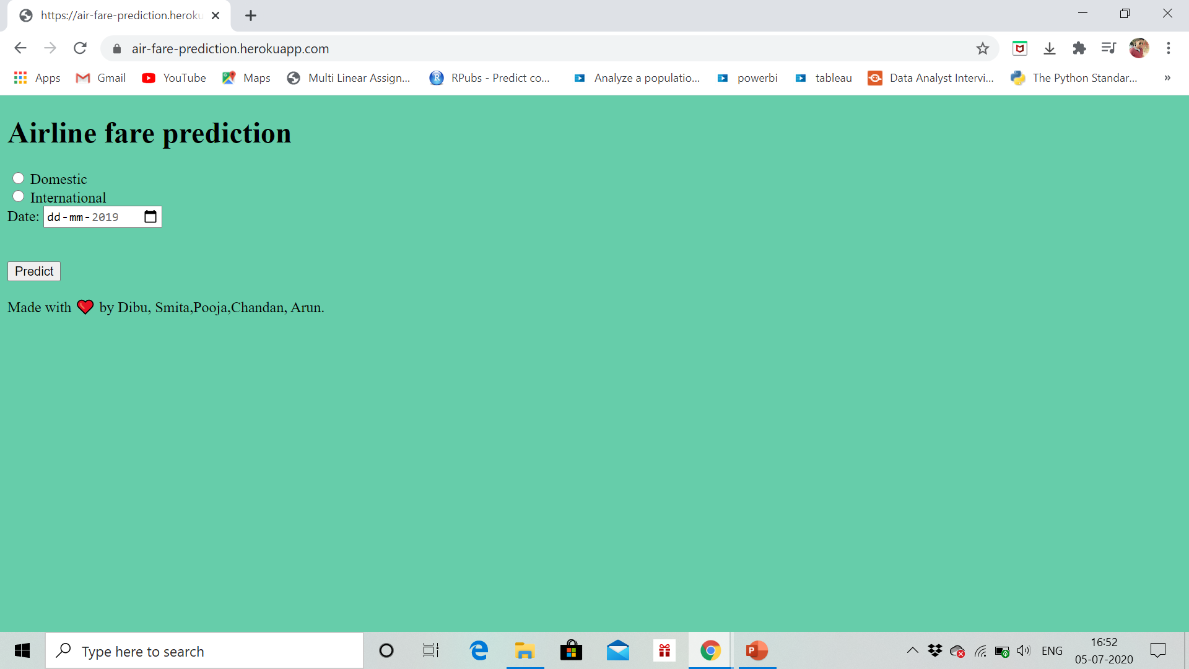
Deployment

Slide 17
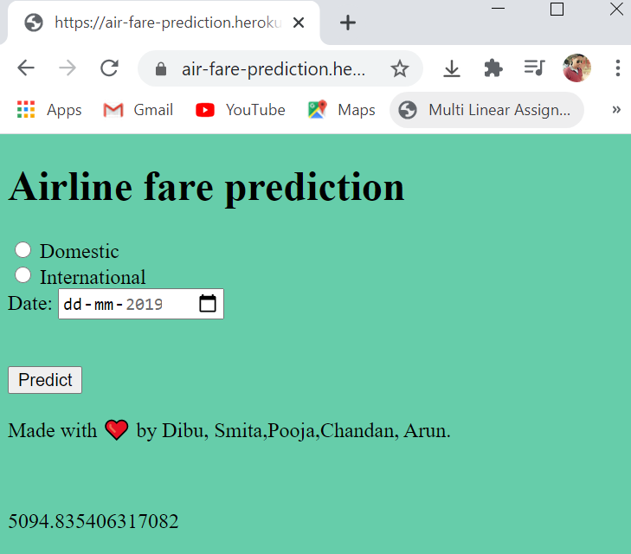
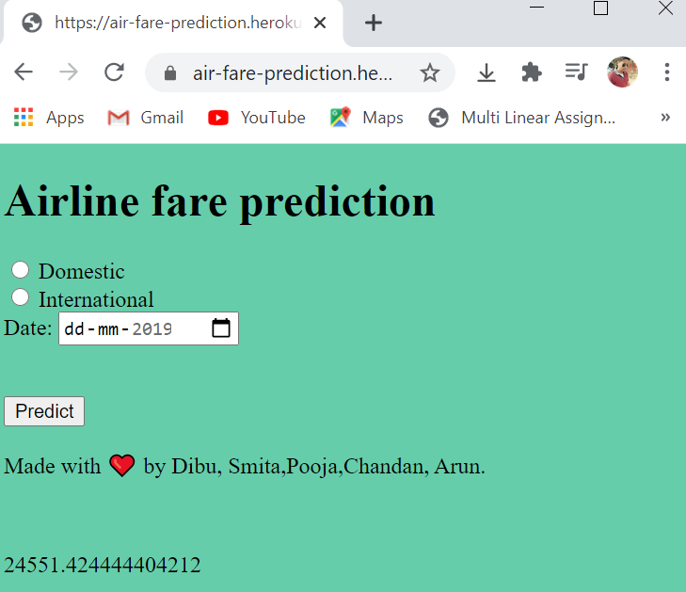
Domestic International

Slide 18
Thank You!!!

